Slide 1
Recipe Application
By Shirdora Ashe
Notes:
Good evening, my name is Shirdora Ashe and i will be presenting my Recipe android Application

Slide 2
Objectives
Create an application to display budget friendly Recipes
Application’s Recipes are chosen by the developer
Notes:
The objectives of this application is to create a space where those who need budget friendly recipes and discover different ways that they can cook a meal.
This application is aimed to offer young adults and college students a collection of creative and budget-friendly recipes. This application falls under the genre of lifestyle or utility, providing the user with tools for meal planning and cooking. With the goal of accessibility, the application will be free, ensuring the users can enjoy its benefits without financial barriers. The proposed bulk of revenue for the application would come from small ads that would be throughout the application.
The recipes were picked by the developer as these are some of her favorite recipes to make.

Slide 3
Design Elements
Include app bar with a toolbar.
Notes:
Some design elements implemented in this application is a app bar with a toolbar. This will allow user the ability to maneuver to different aspects of the application for example as the account page, pantry list, and saved recipes. Throughout the application the color scheme will be that of pastel purples and pinks. This will appeal to college students, especially female students and those who enjoy pastel colors.
The layout for the recipe will be structured in a way where the information about ingredients and instruction will be easy to read and follow along with important information included.

Slide 4
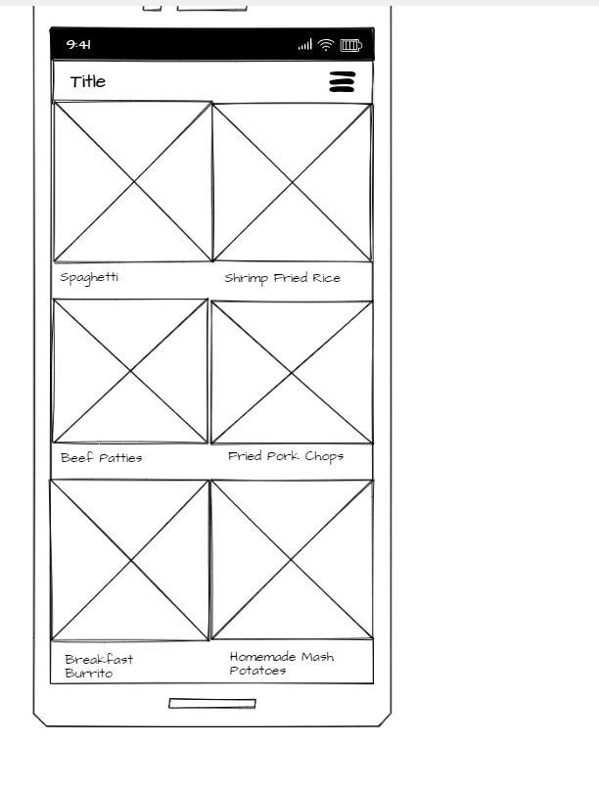
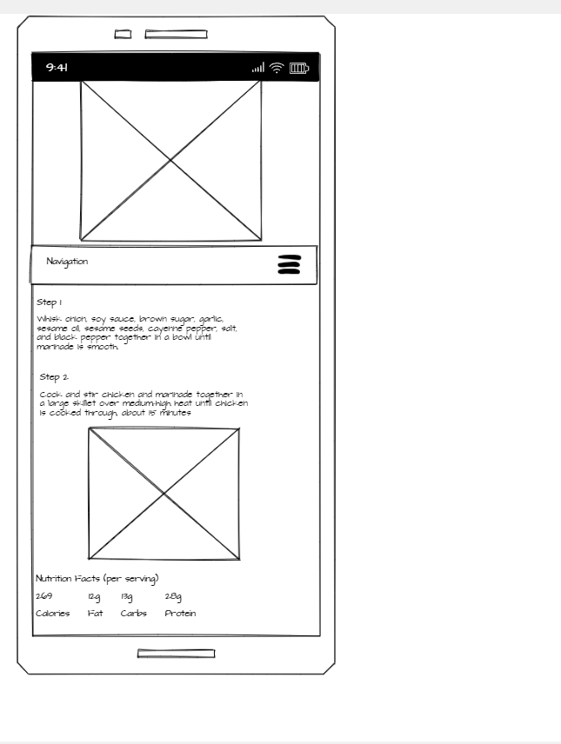
Proposed Storyboard
Notes:
In this slide, is the proposed storyboard of the application. The main page will display a welcome message to the users and display multiple of the recipes. The options from the toolbar can also be accessed by pressing the three dots in the top right corner. The recipe page displays a photo of the finished product along with the ingredients and instructions for the recipe. The calorie information is also present.

Slide 5
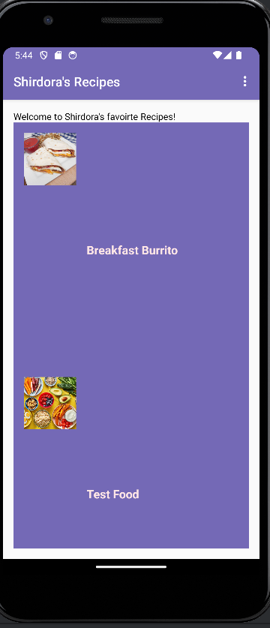
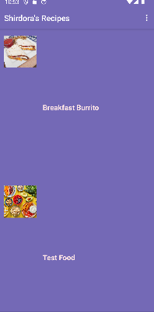
Main Page
Notes:
This slide contains the Main page in the current working of the application. The plan was to have the user to be able to click on the title of the recipe and it will take the user to a page where the recipe will be displayed.

Slide 6
Future Features
Access to the Panty List
Access to the Account page
Access to the Save recipe Page
Access to the Recipe of the Month Page
Notes:
In the future, the plan is to create access to the different options in the toolbar. Currently the basics for the application semi function, there would need to be work done to finish the basics before any of these future features can be created.

Slide 7
Conclusion
In conclusion,
This recipe application strives to display some easy recipes for young adults to discover.

